Slide 1
Lecture 2 Data representation: Unsigned numbers and Signed numbers

Slide 2
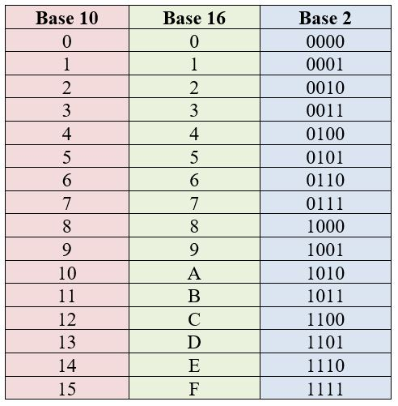
!!!
Dimensions | 8 bits | 8 bits | 16 bits | 32 bits | 64 bits
Data Type | byte | byte | word | doubleword | quadword
Number of Hexadecimal digits | 2 | 2 | 4 | 8 | 16
Registers | AH | AL | AX | EAX | EDX:EAX
 | BH | BL | BX | EBX
 | CH | CL | CX | ECX | ECX:EBX
 | DH | DL | DX | EDX

Slide 3
Instructions for unsigned numbers
MOVZX – move with Zero Extended
MUL - multiplication
DIV - division

Slide 4
Multiplication and Division instructions for unsigned representation (Unsigned representation – contains natural numbers)
Unsigned representation – contains natural numbers [>0]
Notes:
How does the CPU know whether an arithmetic operation is signed or unsigned?
It doesn’t! The CPU sets all status flags after an arithmetic operation using a set of boolean rules, regardless of which flags are relevant.
the programmer decideS which flags to interpret and which to ignore, based on your knowledge of the type of operation performed.

Slide 5
MOVZX instruction (move with zero-extend)
- copies the contents of a source operand into a destination operand and zero-extends the value to 16 or 32 bits
MOVZX reg16, reg/mem8
MOVZX reg32, reg/mem8
MOVZX reg32, reg/mem16
Examples:
mov bx, 0A69Bh ;(in bl is 9B and in bh is A6)
movzx eax, bx ; EAX = 0000A69Bh
movzx edx, bl ; EDX = 0000009Bh
movzx cx, bl ; CX = 009Bh

Slide 6
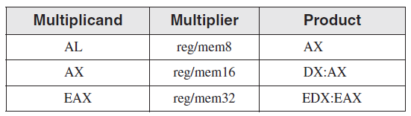
Multiplication Instruction (for unsigned representation)
Syntax: MUL op
op is called explicit operand
The MUL is realized different accordind to the explicit operand:
op is reg/mem8 => MUL reg/mem8 => AL * reg/mem8 = AX
op is reg/mem16 => MUL reg/mem16 => AX * reg/mem16 = DX:AX
op is reg/mem32 => MUL reg/mem32 => EAX * reg/mem32 = EDX:EAX
Notes:
The single operand in the MUL instruction is the multiplier. Table 7-2 shows the default multiplicand and product, depending on the size of the multiplier. Because the destination operand is twice the size of the multiplicand and multiplier, overflow cannot occur.
MUL sets the Carry and Overflow flags if the upper half of the product is not equal to zero.
The Carry flag is ordinarily used for unsigned arithmetic, so we’ll focus on it here.
When AX is multiplied by a 16-bit operand, for example, the product is stored in the combined DX and AX registers.
That is, the high 16 bits of the product are stored in DX, and the low 16 bits are stored in AX.
The Carry flag is set if DX is not equal to zero, which lets us know that the product will not fit into the lower half of
the implied destination operand.
A good reason for checking the Carry flag after executing MUL is to know whether the upper half of the
product can safely be ignored.

Slide 7
Examples: op is reg/mem8 => MUL reg/mem8 => AL * reg/mem8 = AX
Eg 1: 3*4
mov al, 3
mov bl, 4
mul bl ;al*bl = ax
nu mul 4
Eg 2: c*4, c byte
mov al, 4
mul byte [c] ;al*[c]=ax
or
mov al, [c]
mov bl, 4
mul bl; al*bl=ax
Eg. 3 a*b, a, b bytes
mov al, [a]
mul byte[b] ; al*[b] = ax
or
mov al, [a]
mov bl, [b]
mul bl ; al*bl = ax

Slide 8
Examples: op is reg/mem16 => MUL reg/mem16 => AX * reg/mem16 = DX:AX
Eg 1: 3*5
mov ax, 3
mov bx, 5
mul bx ;ax*bx = dx:ax
Eg 2: c*4, c word
mov ax, 4
mul word [c] ;ax*[c]=dx:ax
or
mov ax, [c]
mov bx, 4
mul bx; ax*bx=dx:ax
Eg. 3: m*n, m, n word
mov ax, [m]
mul word[n] ; [m]*[n]=dx:ax
Eg. 4: p*r, p-byte, r-word
mov ax,0
mov al, [p]
mul word[r] ; [p]*[r]=dx:ax

Slide 9
Examples: op is reg/mem32 => MUL reg/mem32 => EAX * reg/mem32 = EDX:EAX
Eg. 1: e*f, e, f doubleword
mov eax, [e]
mul dword[f] ; edx:eax=e*f
Eg. 2: g*h, g-byte, h-doubleword
mov eax, 0
mov al, [g]
mul dword[h] ;edx:eax=rez g*h
Eg. 3: 2*f, e, f doubleword
mov eax, 2
mul dword[f] ; edx:eax=2*f
Eg. 4: i*j, i-word, j-doubleword
mov eax, 0
mov ax, [i]
mul dword[j] ;edx:eax=i*j

Slide 10
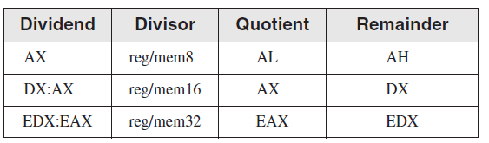
Division Instruction (for unsigned representation)
Syntax: DIV op
op is called explicit operand
The DIV is realized different according to the explicit operand:
op is reg/mem8 => DIV reg/mem8 => AX / reg/mem8 = AL – quotient
and AH – remainder
op is reg/mem16 => DIV reg/mem16 => DX:AX / reg/mem16 = AX – quotient
and DX – remainder
op is reg/mem32 => DIV reg/mem32 => EDX:EAX / reg/mem32 = EAX – quotient
and EDX – remainder

Slide 11
Examples: op is reg/mem8 => DIV reg/mem8 => AX / reg/mem8 = AL – quotient and AH – remainder
Eg. 1: m/n = > word/byte
m dw 31
n db 10
mov ax, [m] ; ax = [m]
Div byte[n] ;ax/[n] = al-cat, ;ah –rest
Eg. 2: 5/r => constant/byte
mov ax, 5
div byte[r] ;ax/[r] = al-cat, ah-rest
Eg. 3: a/b => byte/byte
a db 20
b db 6
mov al, [a]
mov ah, 0 ;ax = [a]
mov bl, [b]
div bl ; ax / bl = a/b = al cat, ; ah-rest

Slide 12
Examples: op is reg/mem16 => DIV reg/mem16 => DX:AX / reg/mem16 = AX – quotient and DX – remainder
Eg. 1: m/n = > word/word
m dw 31
n dw 10
mov ax, [m] ; ax = [m]
mov dx, 0 ;dx:ax = [m]
Div word[n] ;dx:ax/[n] = ax-cat, ;dx, rest
Eg. 2: 5/r => constant/word
mov ax, 5
mov dx, 0
div word[r] ;dx:ax/[r] = ax-cat, ;dx- rest
Eg. 3: a/b => byte/word
a db 20
b dw 6
mov al, [a]
mov ah, 0 ;ax = [a]
mov DX, 0 ;dx:ax = [a]
mov bx, [b]
div bx ; dx:ax / bx = a/b = ax cat, ; dx rest

Slide 13
Examples: op is reg/mem32 => DIV reg/mem32 => EDX:EAX / reg/mem32 = EAX – quotient and EDX – remainder
Eg. 1: m/n = > word/doubleword
m dw 32
n dd 11
mov eax, 0 ; eax=0
mov ax, [m] ; eax = [m]
mov edx, 0 ;edx:eax = [m]
div dword[n] ;edx:eax/[n] = eax-cat, ;edx, rest
Eg. 2: 5/r => constant/doubleword
r dd 3
mov eax, 5
mov edx, 0
div dword[r] ;edx:eax/[r] = eax-cat, edx- rest
Eg. 3: a/b => byte/doubleword
a db 16
b dd 3
mov eax, 0
mov al, [a] ; eax=[a]
mov edx, 0
div dword[b] ;eax – cat, edx avem rest
Eg. 4 c/d =>word/doubleword
c dw 41
d dd 10
mov eax, 0
mov ax, [c] ; eax = [c]
mov edx, 0
div dword[d] ;eax – cat, edx, avem rest

Slide 14
Probl - in unsigned representation (all variables >0, rez>0)
A/B – C*2 + D – 12h
A BYTE
B WORD
C WORD
D – DOUBLEWORD

